Slide 1
Fiver & 1/2
Market place
Project Definition
Team Members:
Emanuel Ben Hamo, Rotem Carmon, Vova Eygel

Slide 2
Highlights
Product Name: Fiverr - TBD
Product Short Description:
Marketplace for web design and development service
Users:
Guest users, Sellers, Buyers, Admin
Key features:
Offer web design & development services, purchase web services, chat between buyers and sellers,
Show sellers reviews & description
Guest mode:
Guest can browse all services offered in the marketplace and look at specific seller details, information & reviews

Slide 3
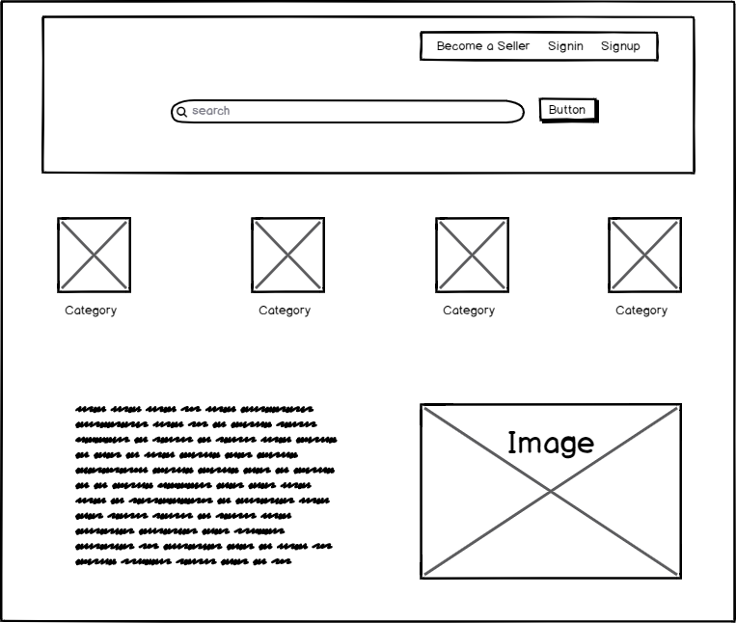
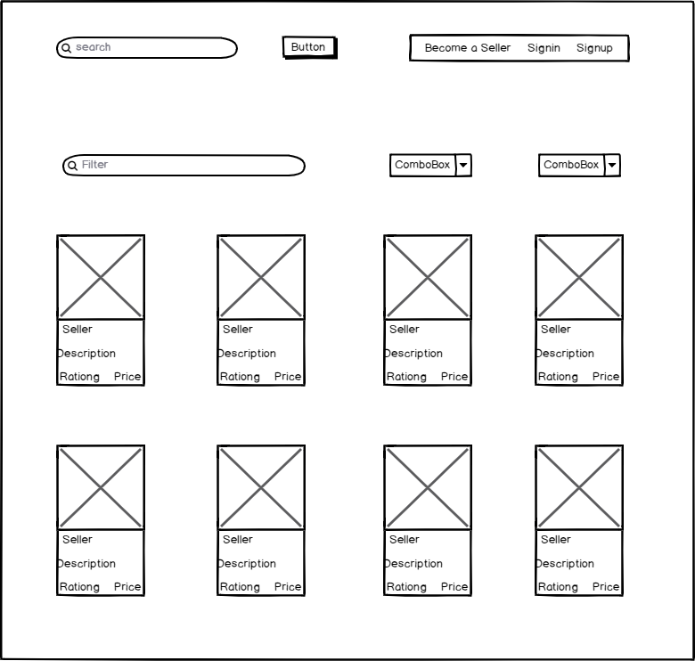
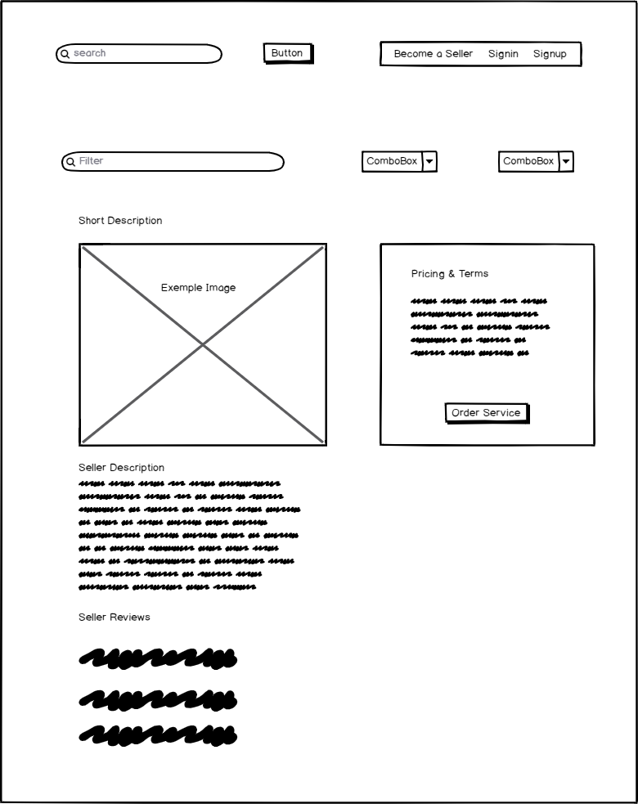
Main Pages
Home page
View the categories of the professional services offered by sellers.
Category list
View all services in a selected category.
Service page
View the details of a selected service (gig).

Slide 4
Main Flows
Clicking a category item on the home screen – user is directed to the services page where the user can view services (product) offered in the selected category.
Clicking a service item on the category screen – user is directed to a single service (product) offered by a seller.
Home page
Categories page
Service (product) page

Slide 5
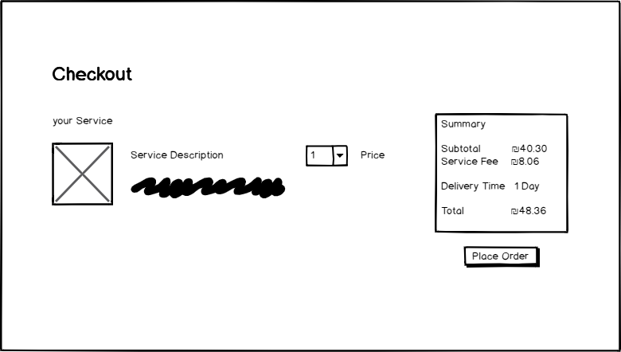
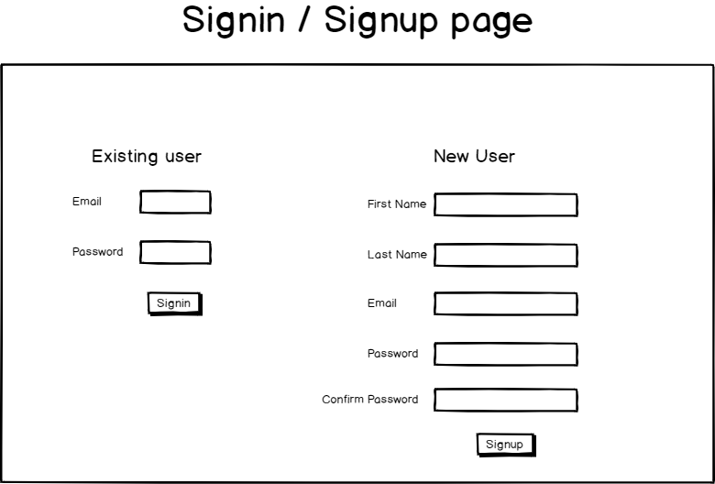
Main Flows
The user clicks the “order service” button, if he is signed in, the app will redirect to the checkout page.
If signed in
else
If the user is not signed in, the app will redirect to the login/signup page.

Slide 6

Main Pages UX

Slide 7
Home page
Top fold

Slide 8
Service (product) page

Slide 9
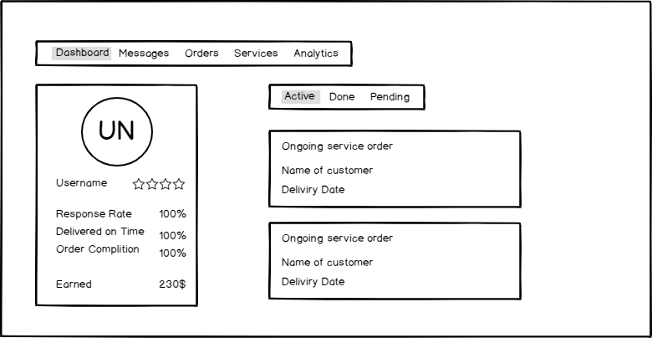
Seller profile

Slide 10
sign

Slide 11
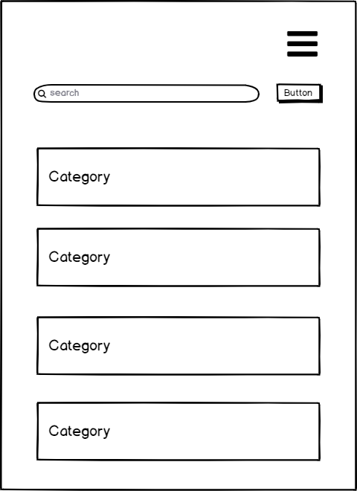
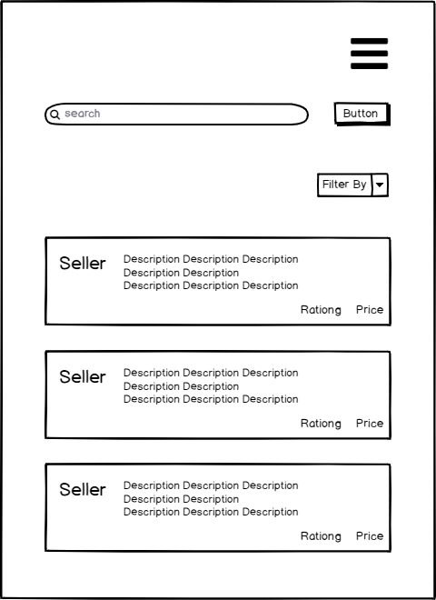
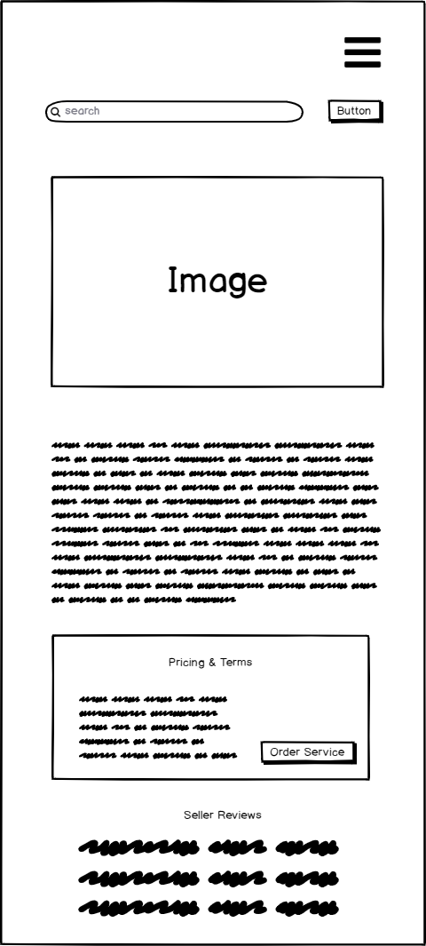
Mobile view

